Slide 1

Poisson Image Editing
By George Wu

Slide 2

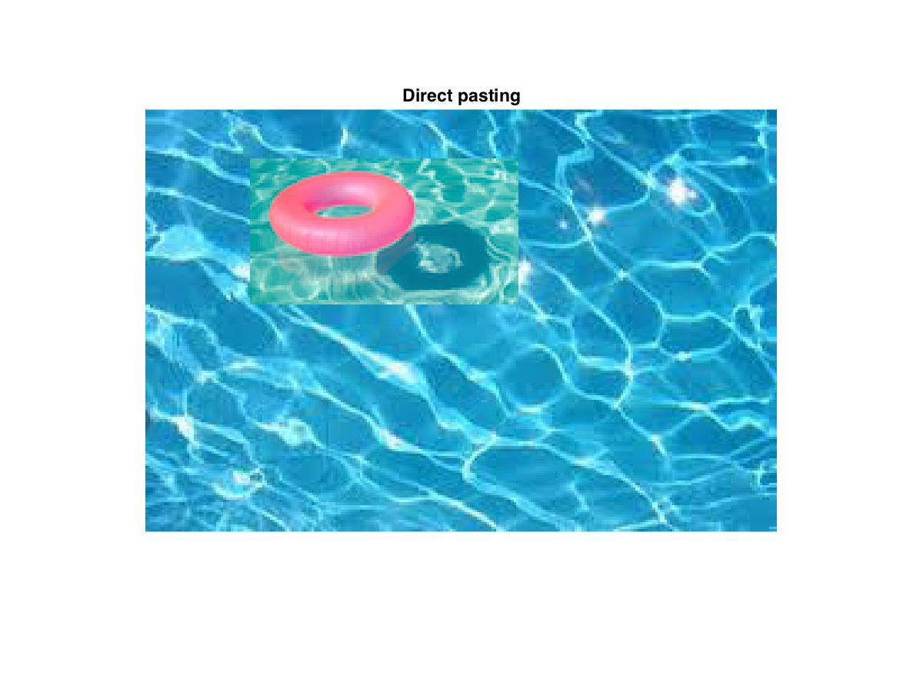

Motivation
Editing photos have become more and more popular
But directly copying and pasting isn’t the most ideal method.

Slide 3
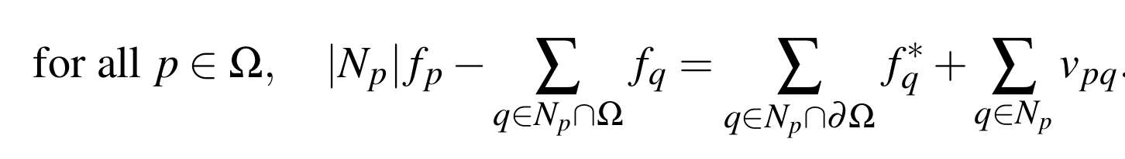
Seamless Cloning
To do this more seamlessly, solve a discrete Poisson equation with Dirichlet boundary conditions.
For a region , we can form a system of linear equations.
f is what we want to solve for, f* is the background image, and v is the gradient of the source image.
The border of f is determined by f*.

Slide 4
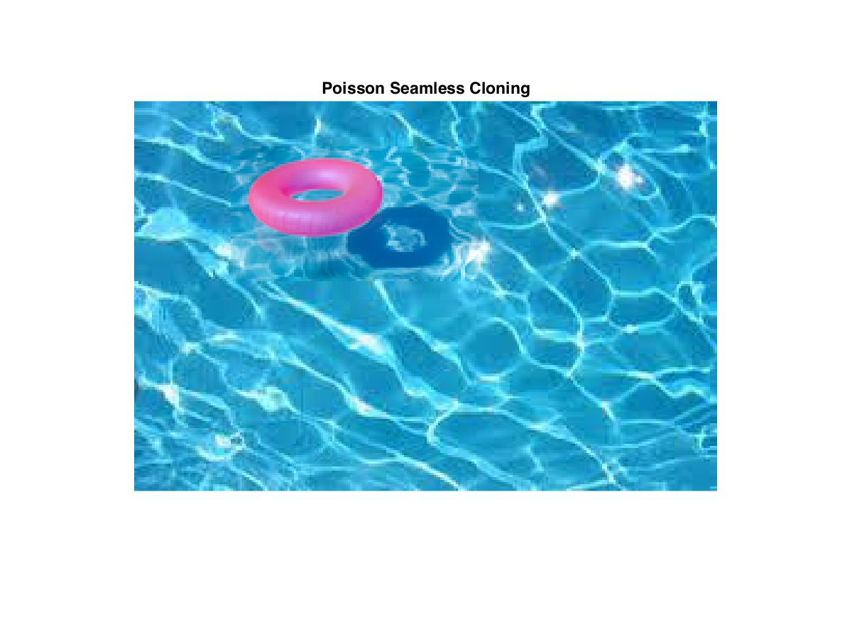
Seamless Cloning

Slide 5
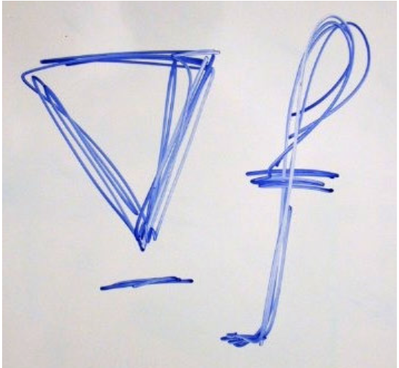
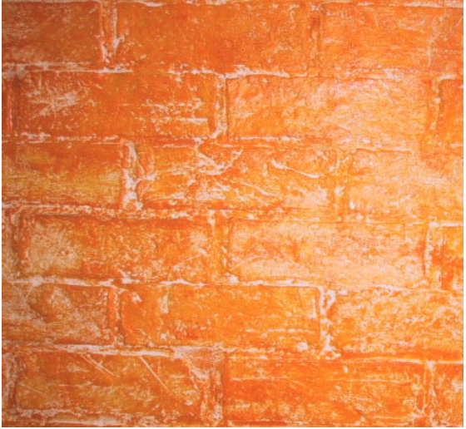
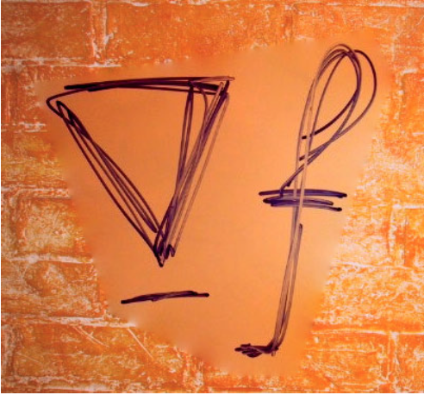
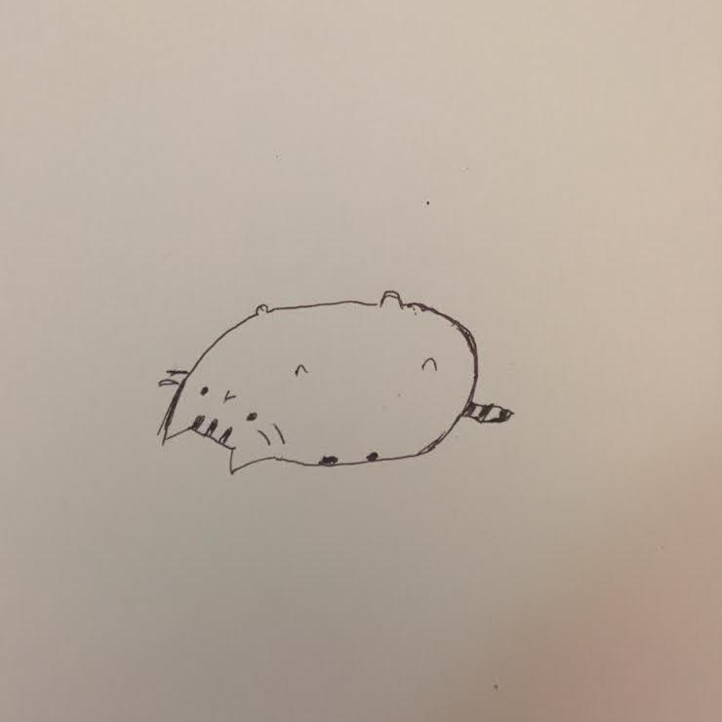
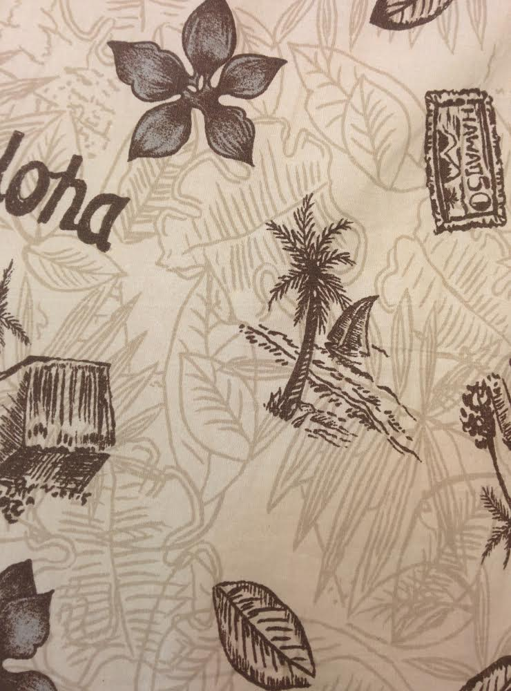
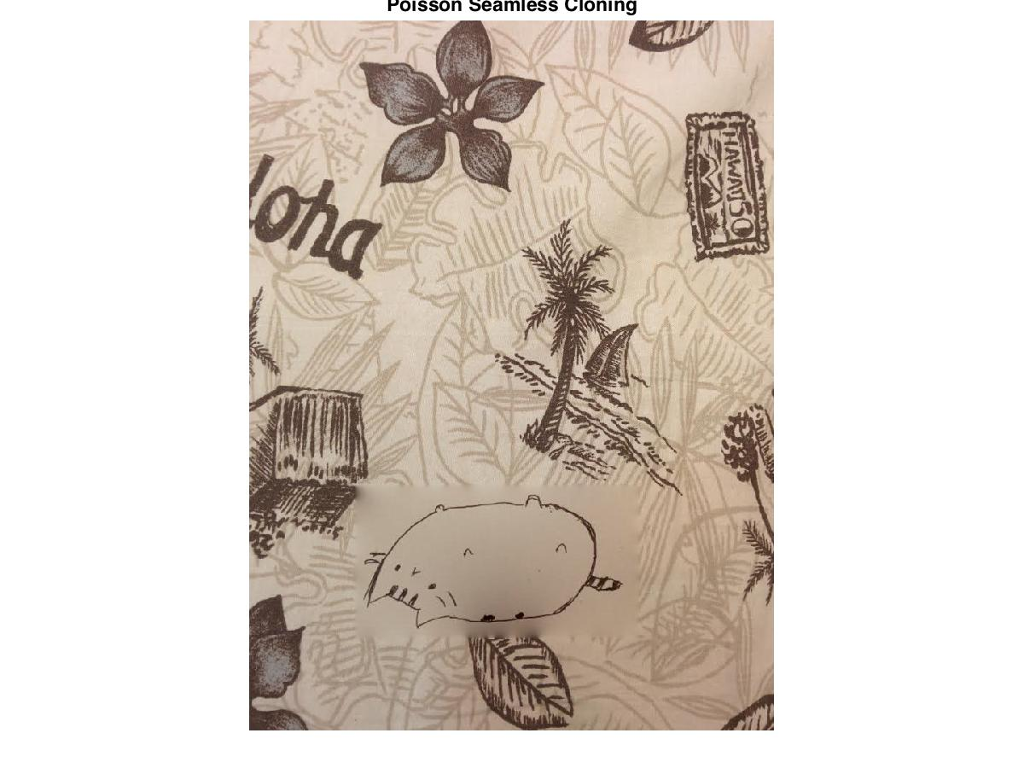
Objects with holes
What if you have a source image with holes?
+
+

Slide 6
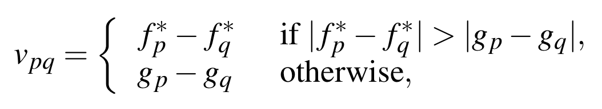
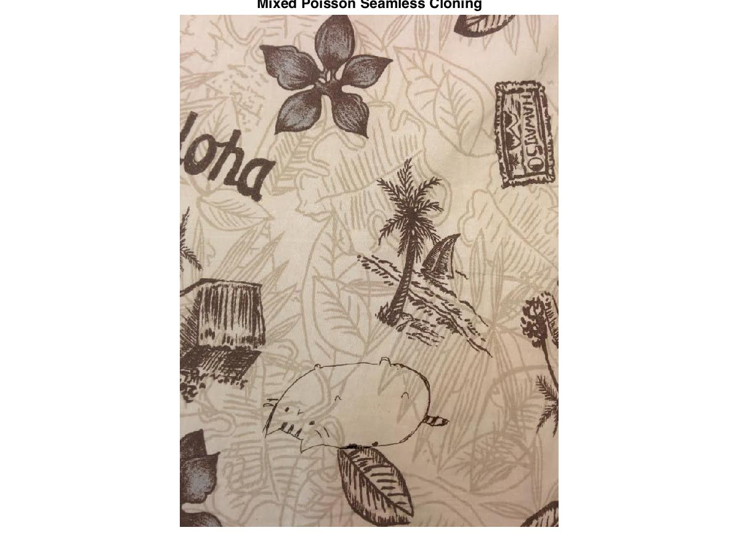
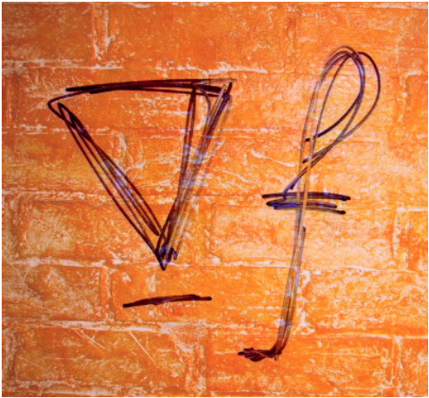
Mixed Seamless Cloning
Take the larger of the two gradients (source and background)

